Slide 1
Challenges of Operating on Liquid Fuel
Plant Manager’s Meeting
September 16, 2026

Slide 2


Insert photo of your “4” here

Slide 3
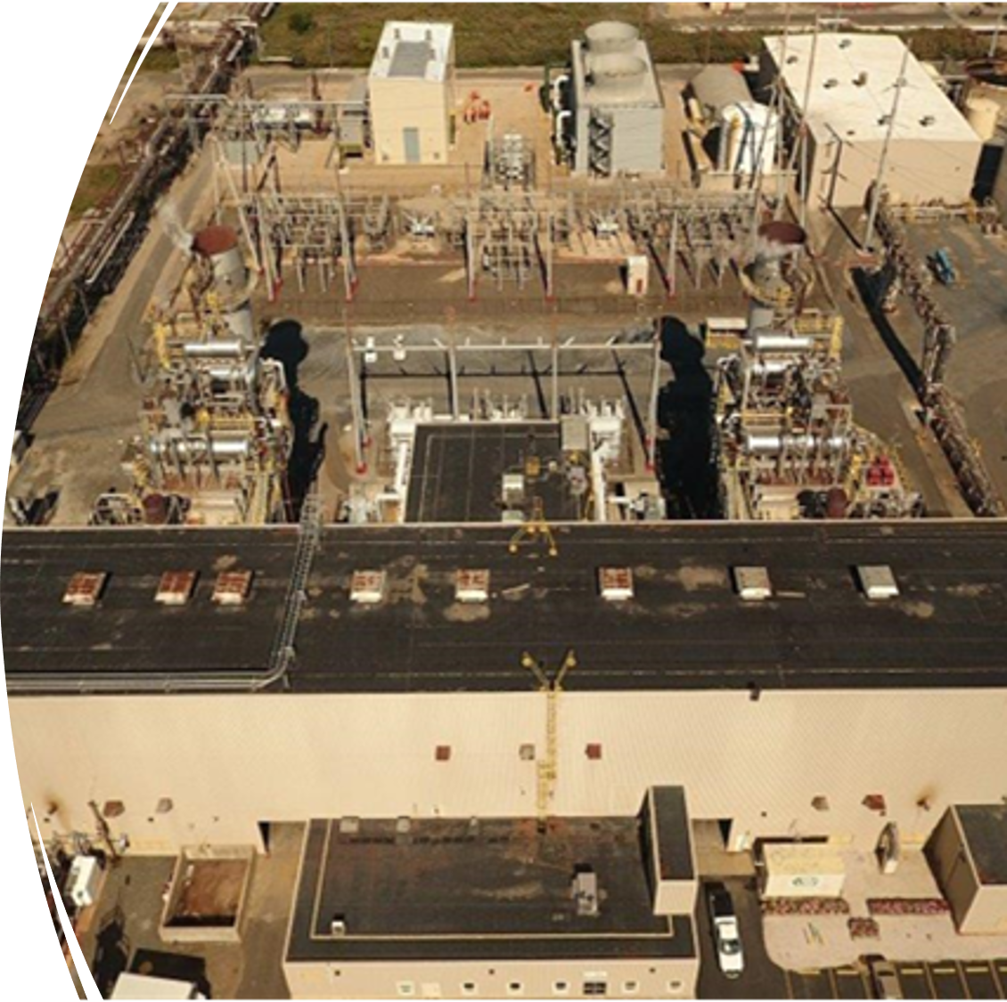
Challenges of Operating on Liquid Fuel
about Eagle Point
Eagle Point Power Generation; 237MW 2 X 2 facility; 2 GE 7EA combustion turbines, ABB Vax steam turbine, Siemens SST 400 steam turbine, 2 Nooter/Erickson Heat Recovery Steam Generators
Plant commissioned 1990
Originally build with liquid fuel and water injection systems
Liquid fuel systems abandoned by Sunoco
Liquid fuel systems re-commissioned 2017 and 2019 by Rockland

Slide 4
Challenges of Operating on Liquid Fuel
a Brief History
Stack testing was completed in 2017
First time unit called on in an emergency, was January 31, 2019. Unit was not dispatched long enough to make it to full load.
The facility would run the units each year outside of ozone season.

Slide 5
Practices/challenges
Challenges of Operating on Liquid Fuel
Removed liquid fuel hoses and steamed them; put new or cleaned hose in place
Removed all check valves; bench tested rebuilt/replaced as necessary
Took liquid fuel pressure readings to determine plugged nozzles
Created test rig to flow check primary fuel nozzles
Attempted to steam out primary fuel nozzles through liquid fuel distributors
High Combustion spread temperature trips
Leaks at fuel and water blocks

Slide 6
Winter Storm Elliot
Challenges of Operating on Liquid Fuel
Christmas weekend 2022
PJM Declared a capacity performance event
  Plant output reduced to 98MW of 237MW capacity
  Fined roughly $17 million

Slide 7
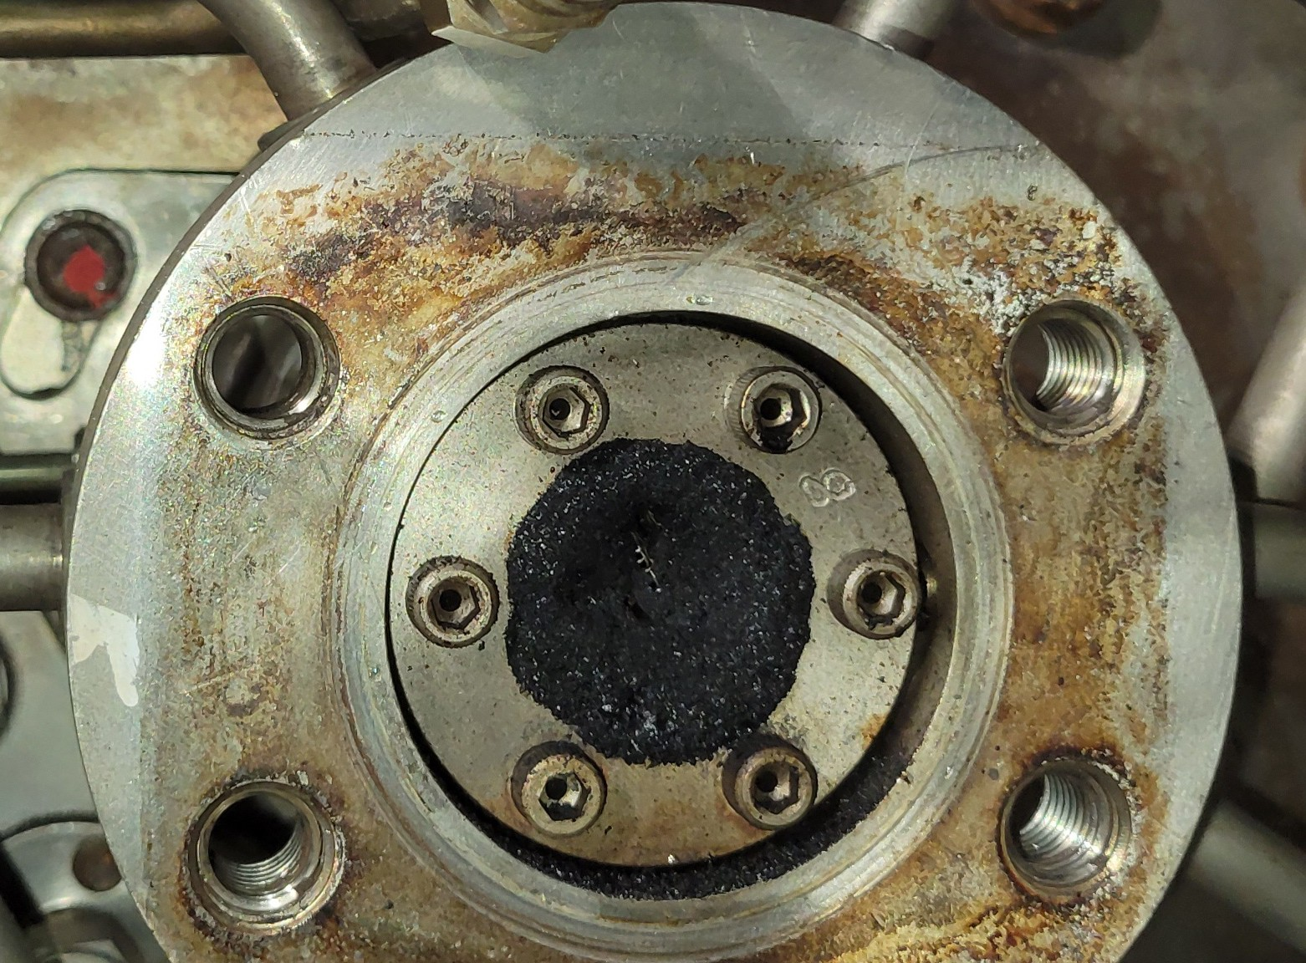
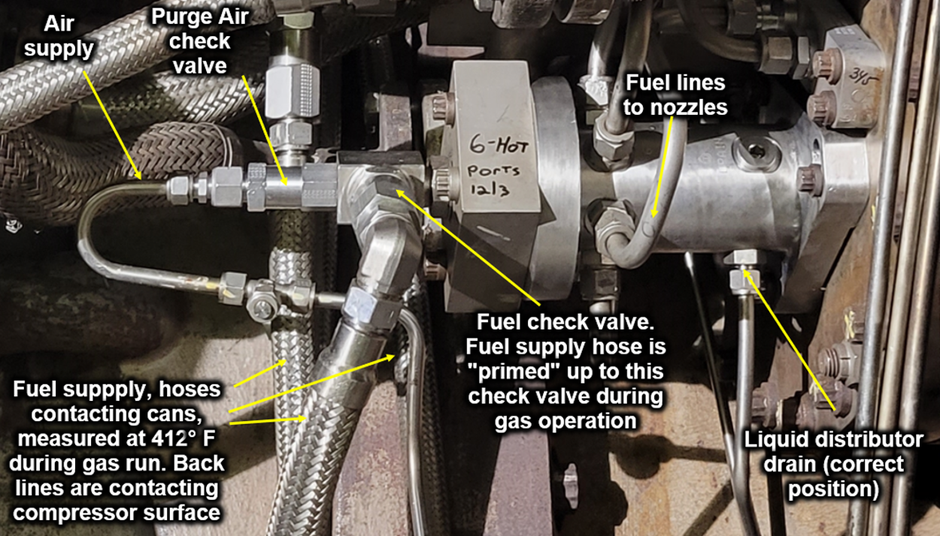
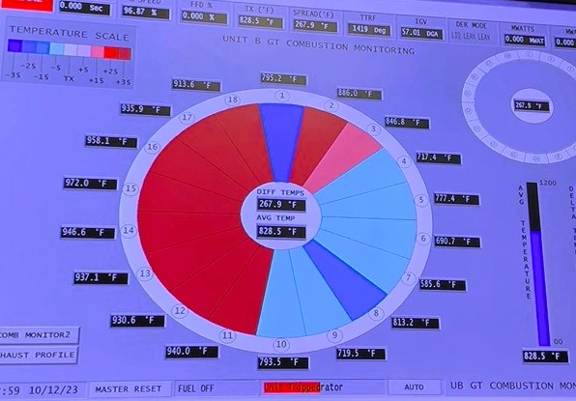
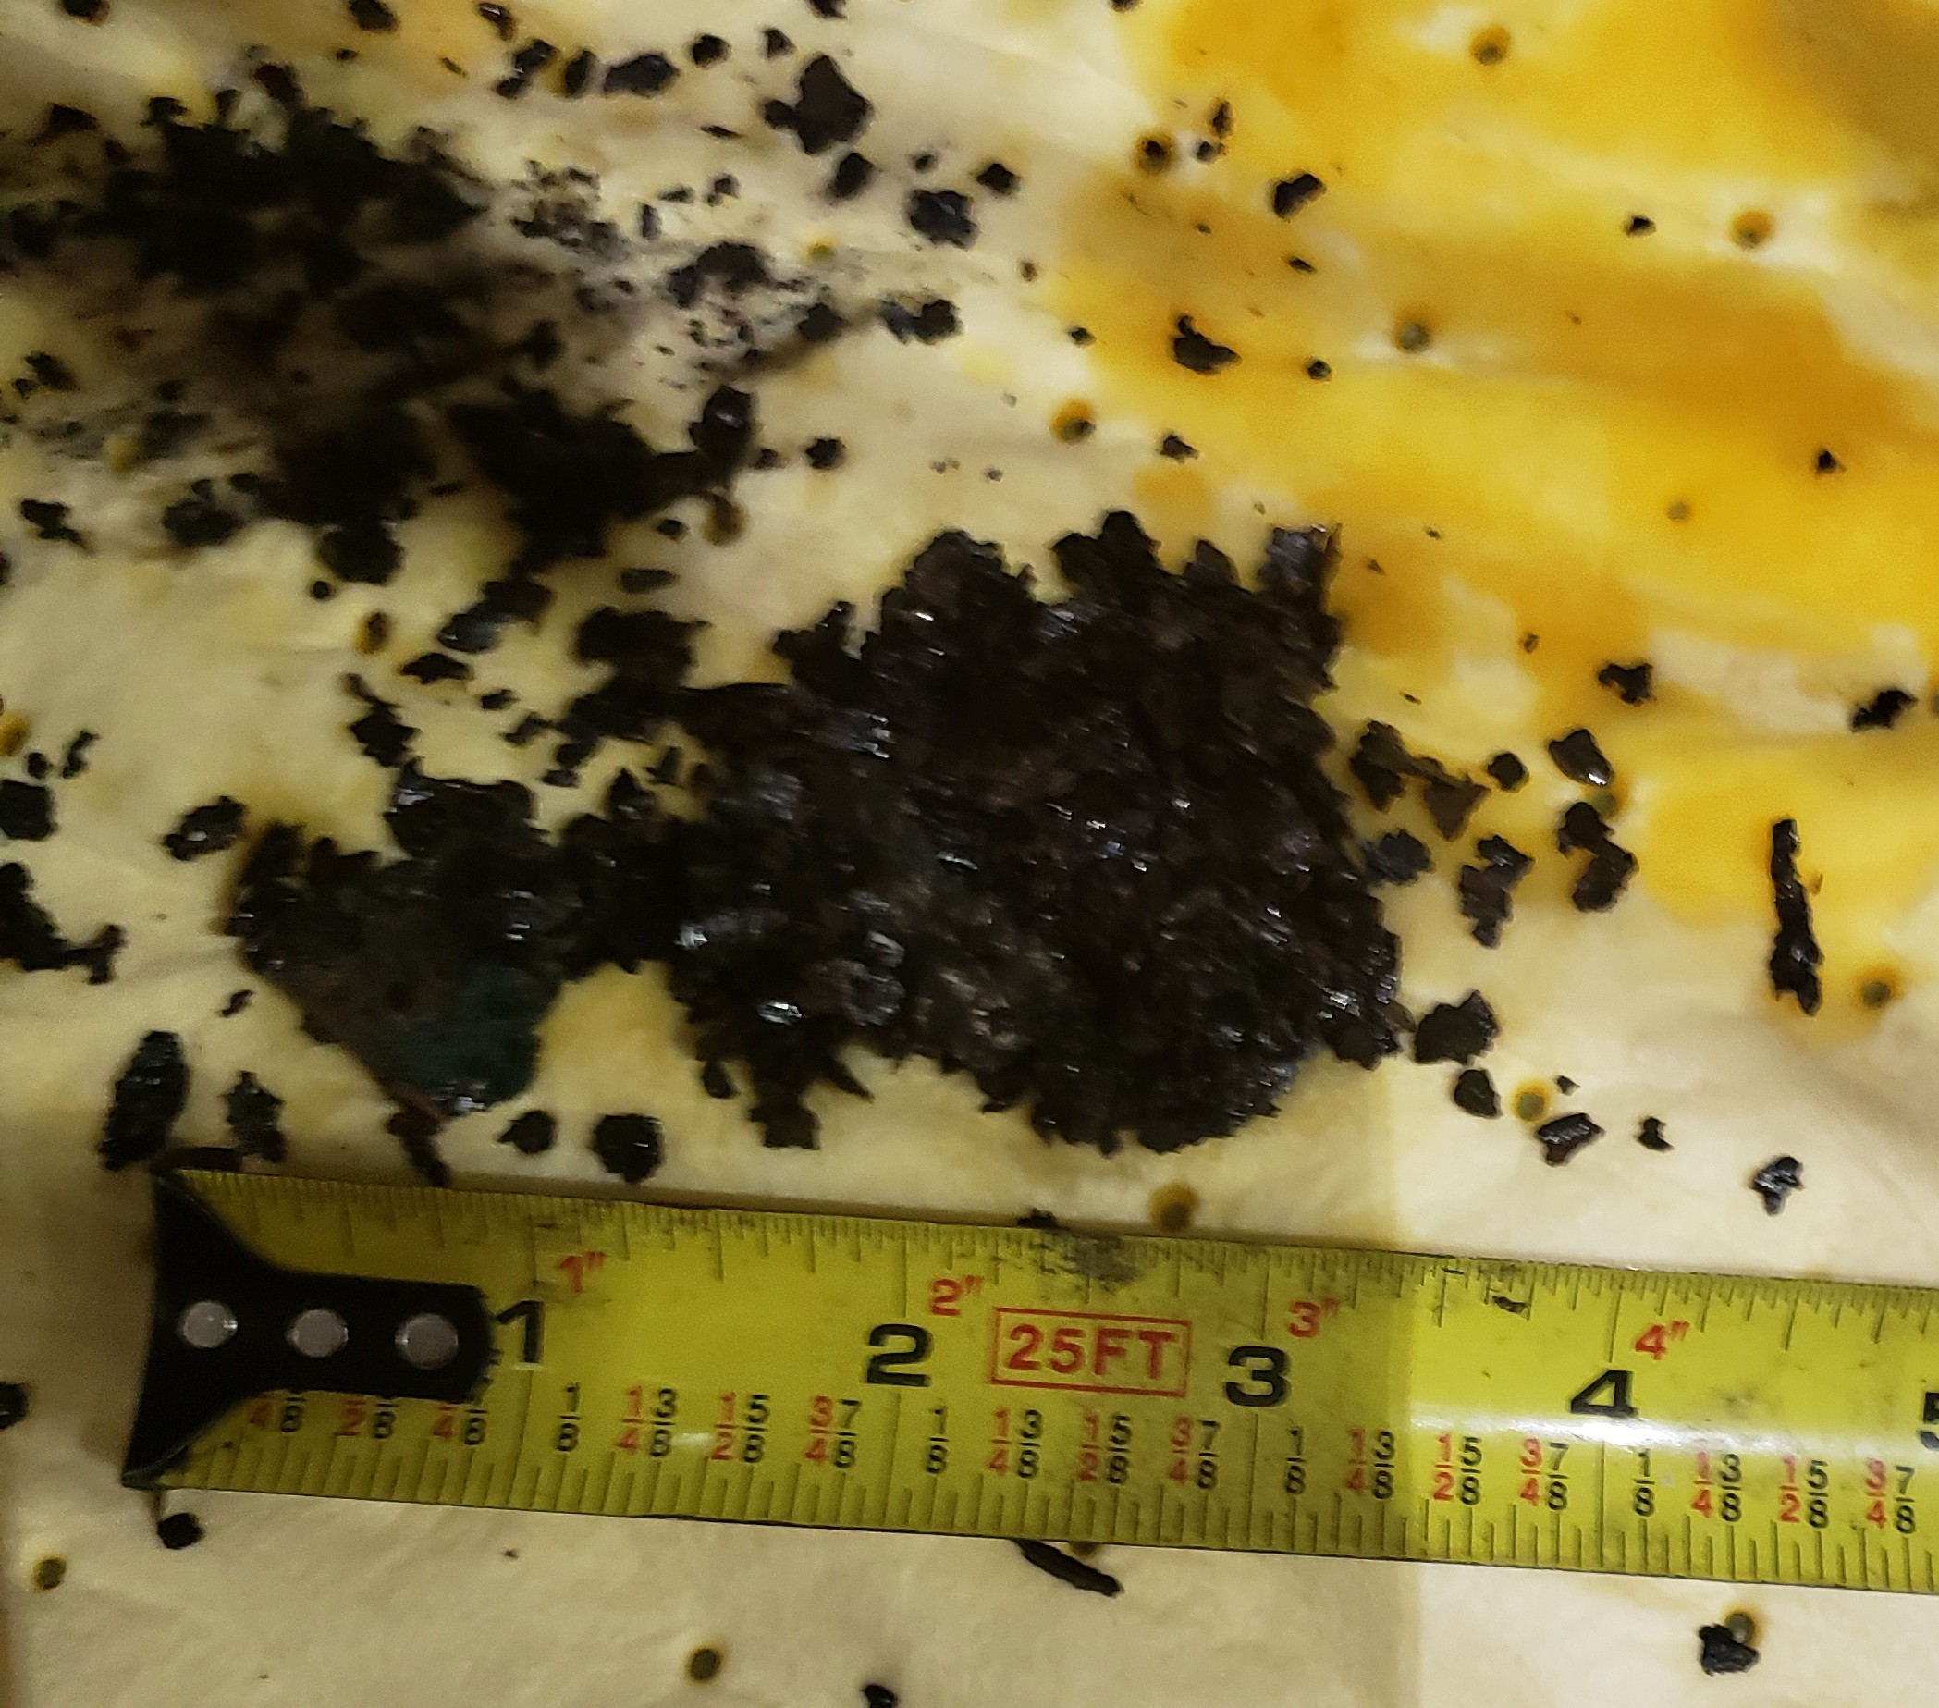
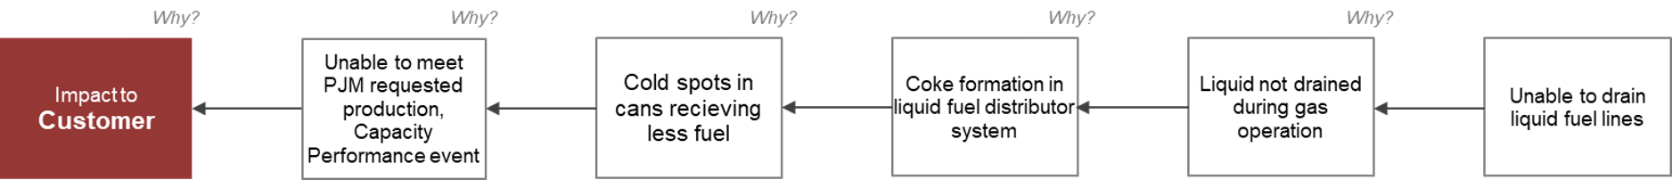
Challenges of Operating on Liquid Fuel
Root Cause; The 5- Why’s

Slide 8
Challenges of Operating on Liquid Fuel
Coke Formation in Liquid Fuel lines
Fouled liquid fuel nozzles, check valves and poppet assemblies
Coke forms in liquid fuel lines while operation on natural gas
Other contributing factors:
Fuel lines are full to the check valves
Fuel lines are inside the high heat area
Fuel lines in contact with hot compressor shell casing
Fuel lines not designed to be drained

Slide 9
Challenges of Operating on Liquid Fuel
What to Do?
Solutions from root cause analysis:
  Remove liquid fuel from supply lines
  Reposition drains on liquid fuel distributor
  Move liquid fuel check valves
  Add tee to allow draining of lines downstream of check valves

Slide 10
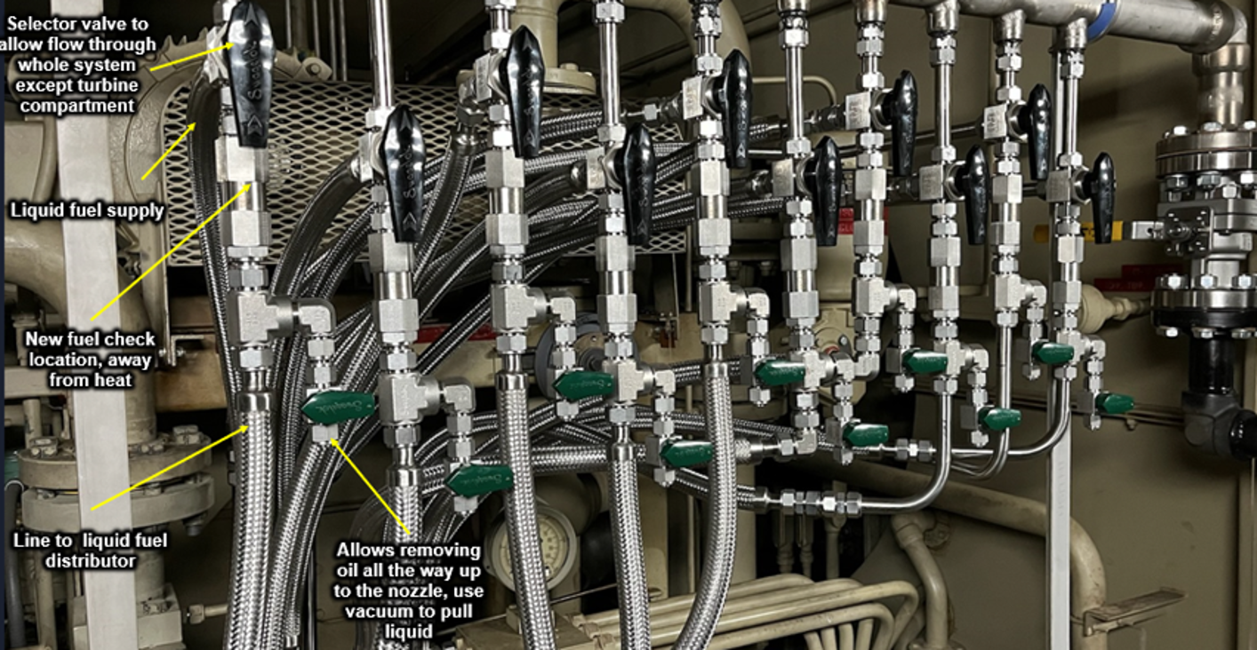
Challenges of Operating on Liquid Fuel
What to Do?
Benchmarking
  Asked GE if there was a system to purge liquid fuel lines
  Talked with other plants that burned liquid fuel
  How do we eliminate hoses
Toured our sister plant and reviewed their purge system
  Uses vacuum to draw the liquid fuel from the lines to a drum
Received advice to use the compressor pressure to blow the lines out

Slide 11
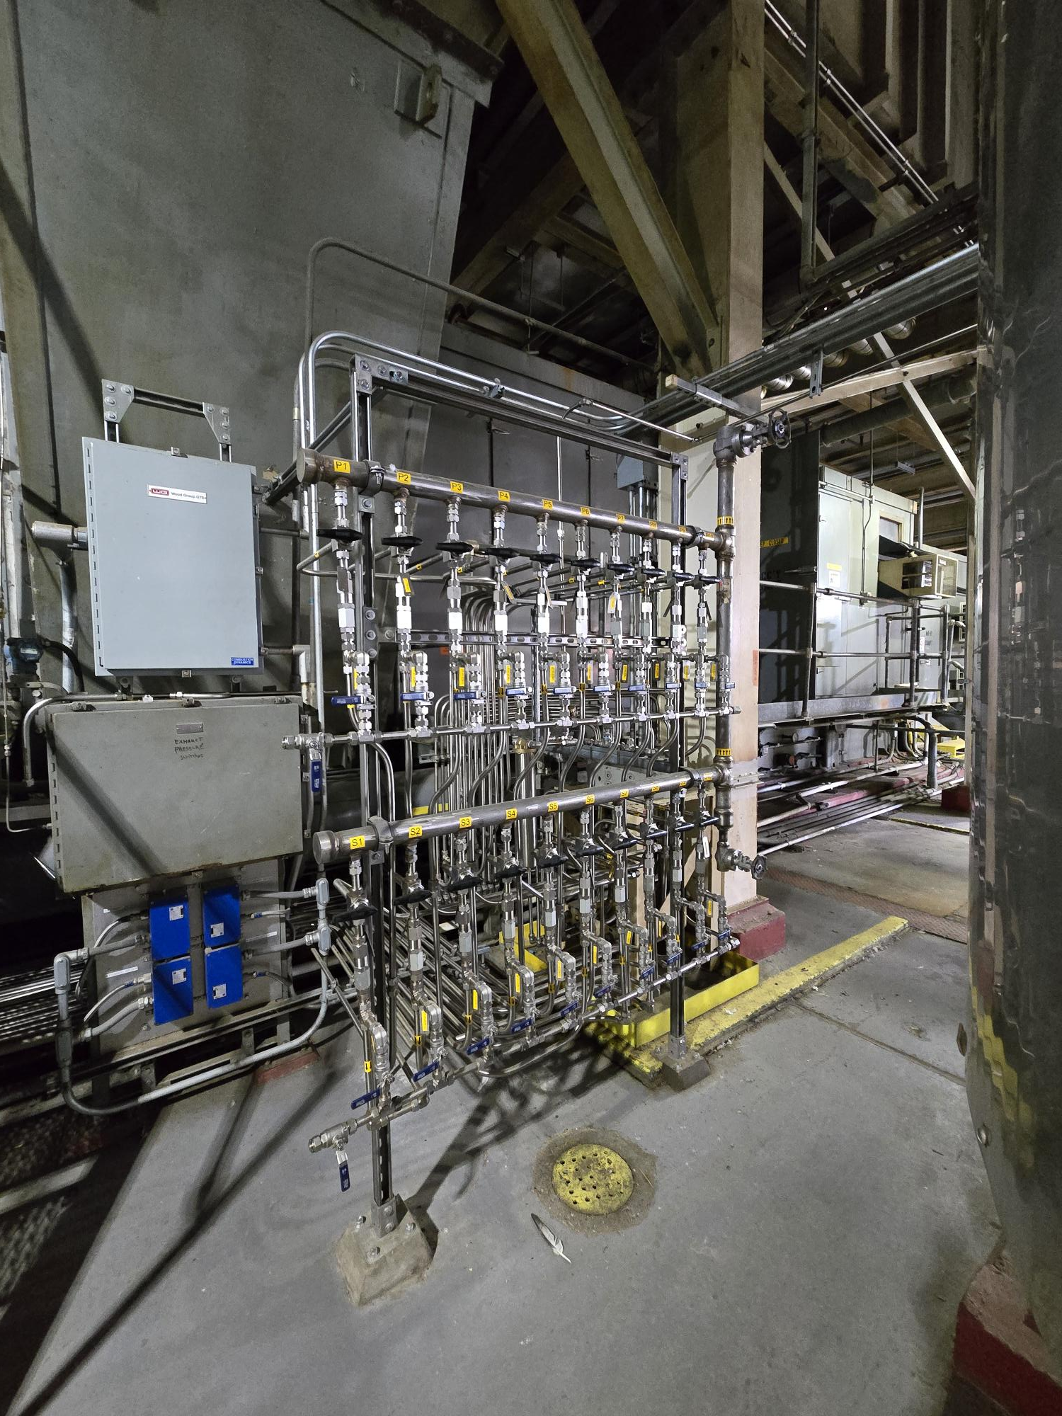
Challenges of Operating on Liquid Fuel
Solution
Hired NAES engineer to ensure the piping modification did not cause any unintended issues
We would use the compressor discharge pressure to blow the lines out
  This is completed during the next natural gas run or a full speed no load situation
  About 15 gallons of fuel from Primary and Secondary lines combined
Following the offline water wash guidance, we flush the liquid fuel lines with demin. water. Observe the liquid fuel and water draining from the false start drains
Lastly blowing the water back with the compressor pressure the next available time

Slide 12
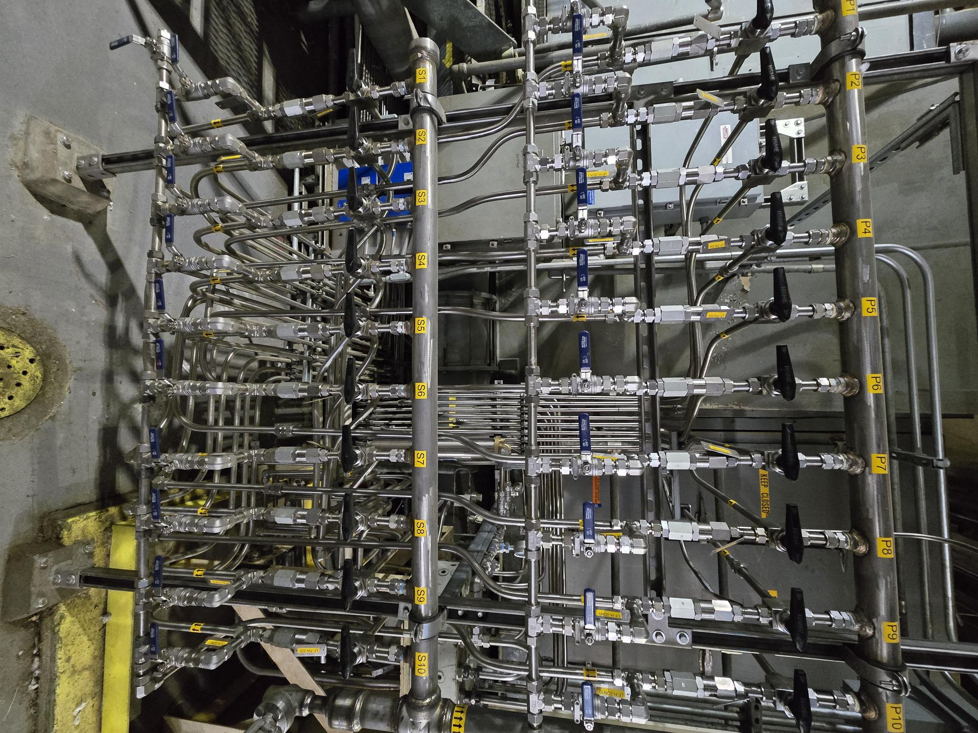
Challenges of Operating on Liquid Fuel

Slide 13
Challenges of Operating on Liquid Fuel
The Payback
Cost of purge system ~$350,000 for both units; installation complete Fall 2024
January of 2025 dispatched for three days around the clock on liquid fuel and made ~1.1 million in revenue
During a Nor’easter in January 2026, dispatched for nine days straight on liquid fuel. Made ~$10 million in revenue

Slide 14
Challenges of Operating on Liquid Fuel
Still Issues To Overcome
Still addressing liquid fuel and water leaks at block connections; trying new o-rings kalrez 6375 $78/ea
Need to fine tune water injection
Need to fine tune transition from Lean-Lean to primary to prevent trips on the way down
Need to tune to the units for 10 more megawatts

Slide 15
NAES Corporation
1180 NW Maple Street
Suite 200
Issaquah, WA 98027
425.961.4700
www.naes.com

