Slide 1

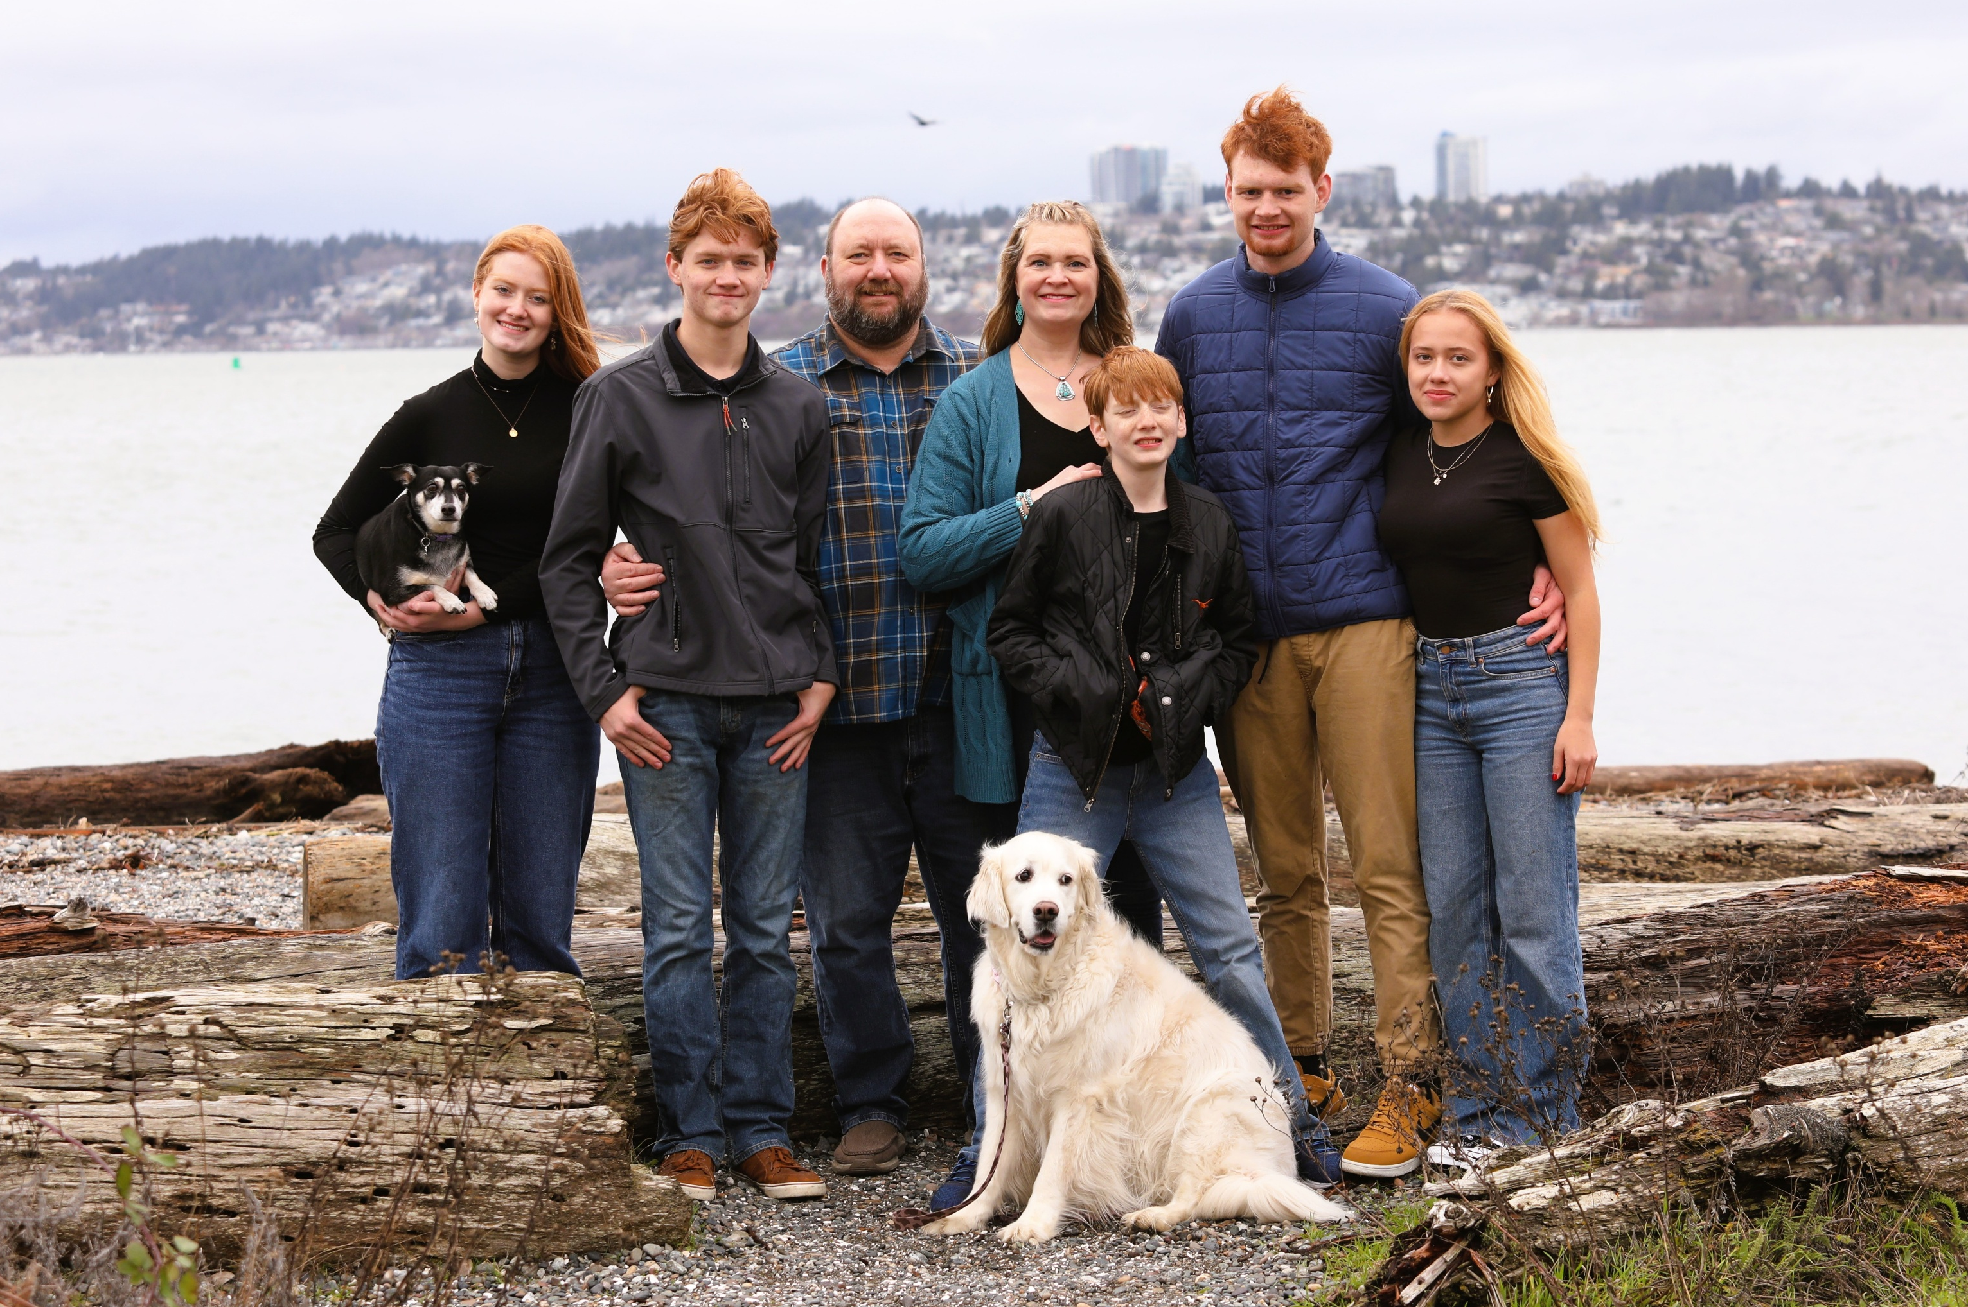

Terry Grumbles
PROTECT YOUR 4
2
Notes:
This is the personal safety connection.,At Ferndale, we use “Protect Your 4” as a reminder that everyone has people, pets, or others they go to work for and need to return home to.,

Slide 2
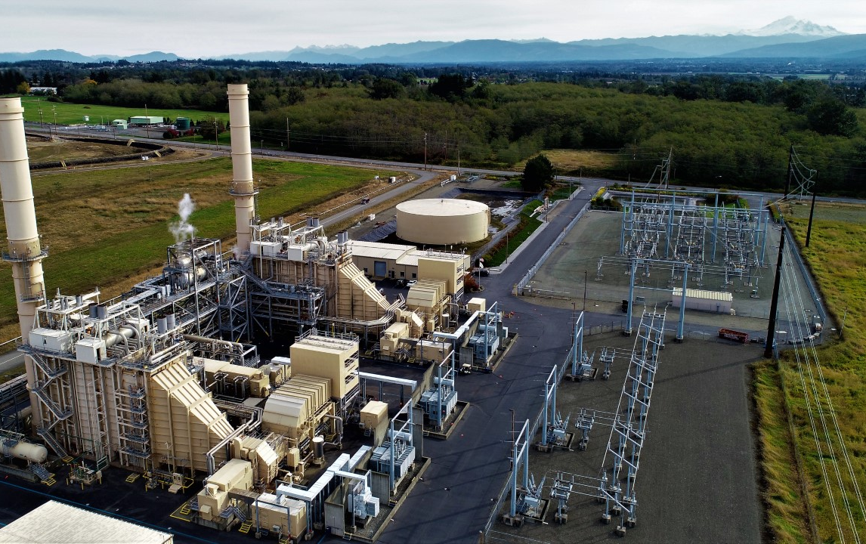
Ferndale Generating Station
Location: Ferndale, WA
MW Output: 270 MW
Combined Cycle Facility
2 GE 7EA Gas Turbines
1 SAC-2 Steam Turbine
ABB HRSGs
Water/Wastewater treatment plant
1
Notes:
Opening: Briefly orient the audience to Ferndale before moving into the case studies.,Ferndale is a 270 MW combined-cycle facility in Ferndale, Washington.,Keep this slide to about 30–45 seconds
then transition: the first case study reinforced why personnel exposure has to stay at the center of our decisions.

Slide 3
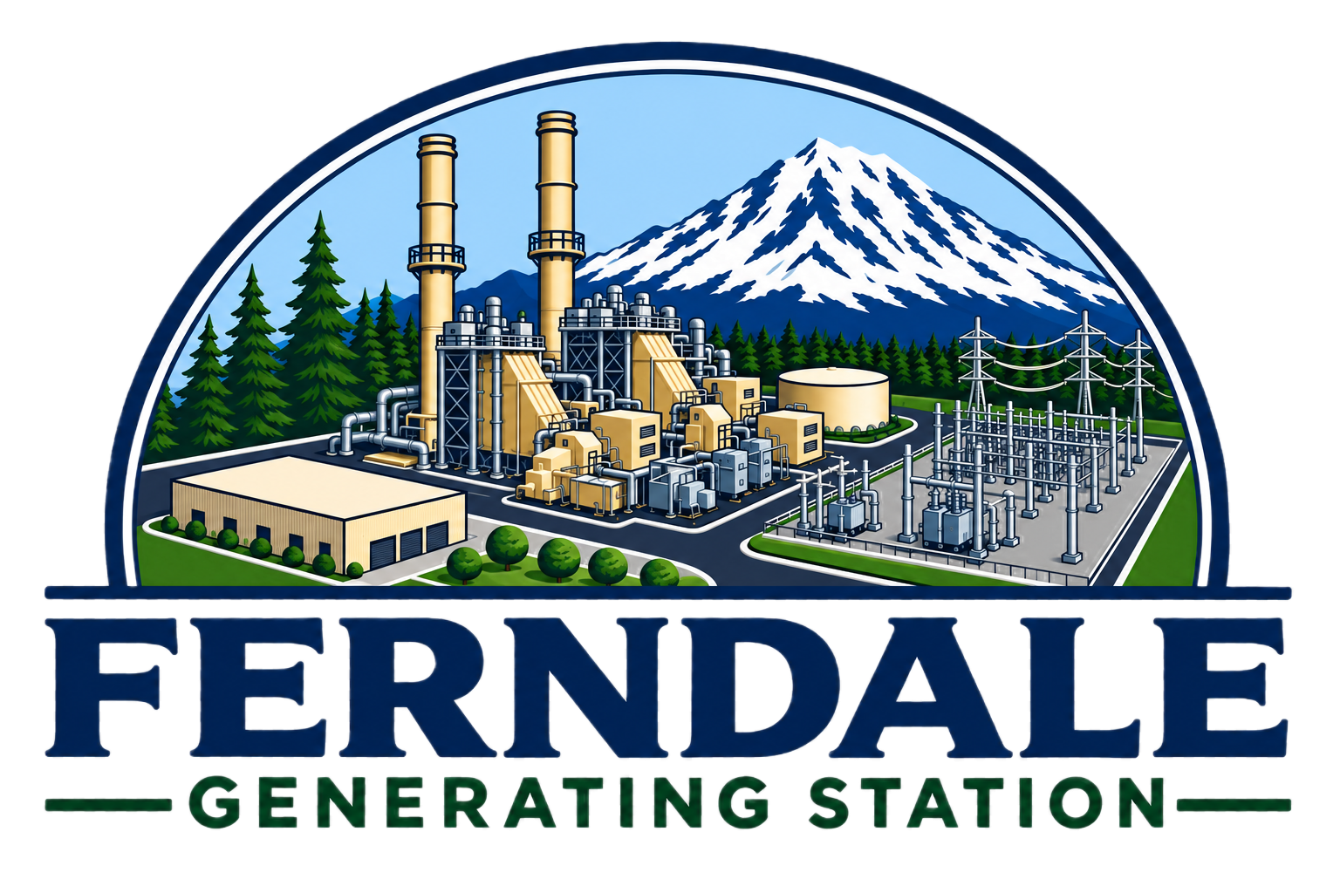

Events to Improvements
Events to Improvements:
Lessons from Ferndale Generating Station
3
Notes:
Set the theme: these are three very different events, but each exposed a weakness in how work, vendors, or risk were being managed.,The goal is not to relive the events. It is to share what changed afterward and what other plant managers can take back to their sites.,,[Sources]

Slide 4
Three Events. One Management Theme.
Flex Hose Blowout
IT Network Failure
GE Stator Rewind
Vendor oversight
IT/OT boundaries
Contract expectations
OEM oversight Acceptance criteria Quality hold points
QA/QC
Like-kind
MOC
Personnel exposure
Plant Manager question: What did the event reveal about the system around the work?
4
Notes:
Preview the three case studies.,The technical details are different, but I want to look at each one through a Plant Manager lens: What did our management system allow? What did we assume? What did we verify? What changed?

Slide 5
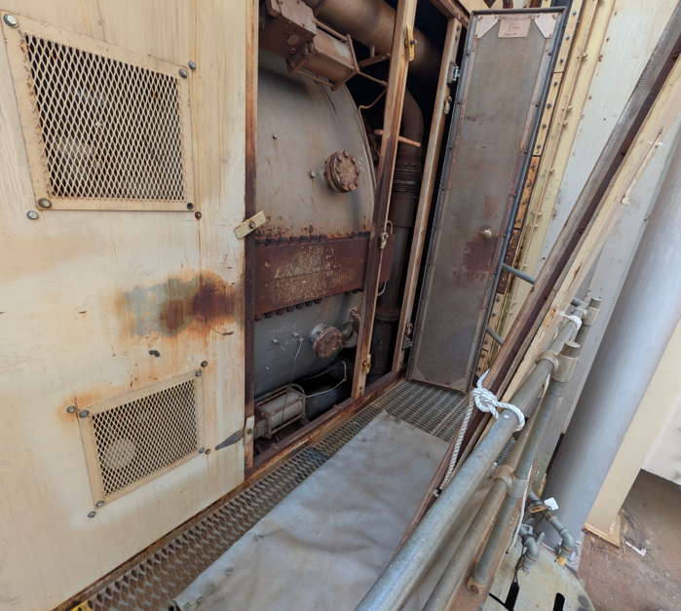
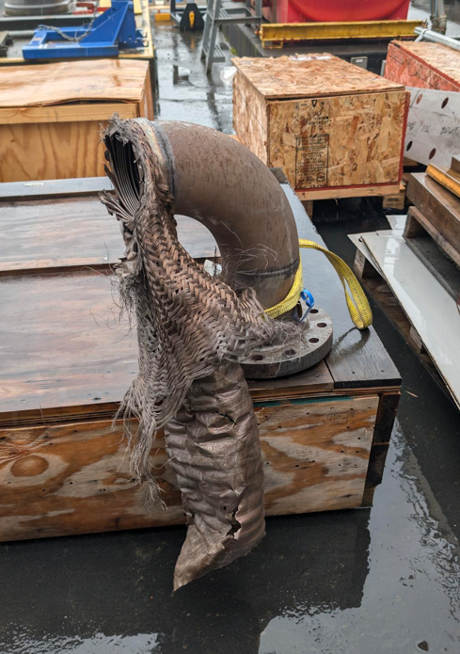
Flex Hose Blowout | What Happened?
APRIL 14, 2026 | 7:01 AM
CT-A tripped after the compressor-discharge flex hose ruptured inside the turbine compartment.
• ~180 psig / 700°F air release
• Fire system actuated; CO₂ discharged
• Thermocouples, conduit and doors damaged
• Operator was approaching CT-A during rounds
5
Notes:
On April 14 at 7:01 AM, CT-A was online and had just been released for dispatch when the compressor discharge flex hose feeding the atomizing-air header ruptured. The release was approximately 180 psig and 700°F.,The fire system actuated and CO₂ discharged. We had damage to thermocouples, wiring, conduit and doors. There was no actual fire.,The detail that changed how we looked at the event was that an operator was approaching CT-A during rounds. The equipment damage mattered, but the potential personnel exposure became the bigger management lesson.,,[Sources],Ferndale - CT-A CPD Line Rupture RCA Draft2.xlsx, Problem and Timeline worksheets; user-provided RCA photos.

Slide 6
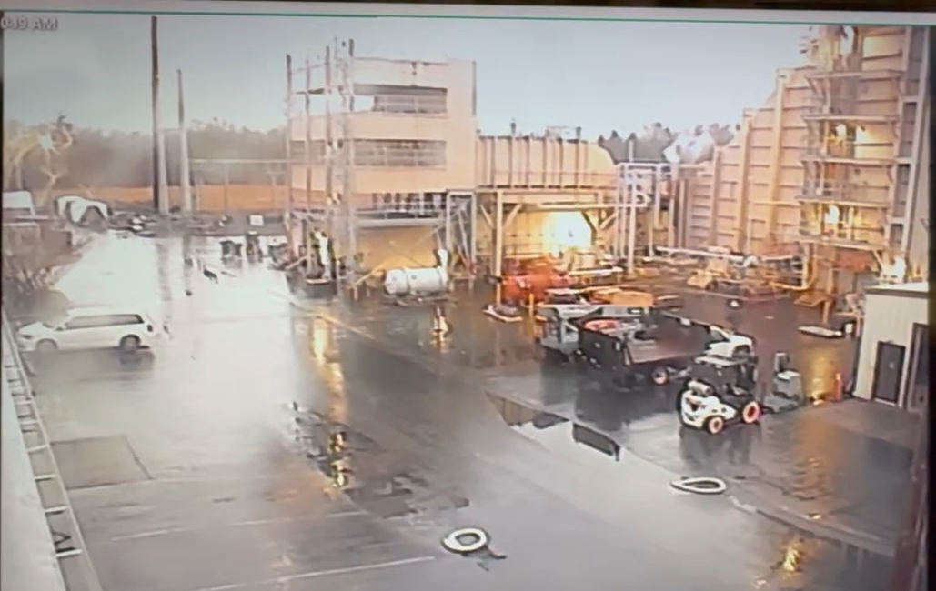
Flex Hose Blowout | What Happened?
The equipment damage was significant.
The personnel exposure was the bigger lesson.
5
Notes:
On April 14 at 7:01 AM, CT-A was online and had just been released for dispatch when the compressor discharge flex hose feeding the atomizing-air header ruptured. The release was approximately 180 psig and 700°F.,The fire system actuated and CO₂ discharged. We had damage to thermocouples, wiring, conduit and doors. There was no actual fire.,The detail that changed how we looked at the event was that an operator was approaching CT-A during rounds. The equipment damage mattered, but the potential personnel exposure became the bigger management lesson.,,[Sources],Ferndale - CT-A CPD Line Rupture RCA Draft2.xlsx, Problem and Timeline worksheets; user-provided RCA photos.

Slide 7
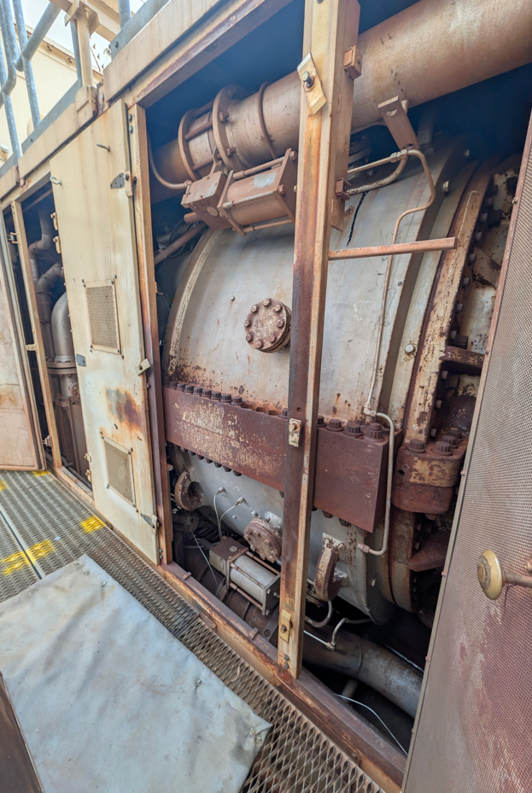
Flex Hose Blowout | How Did We Get Here?
A fast replacement under real outage pressure later became the failure point.
May 2023
May 2025
April 2026
Flat bar left behind
Damage discovered
Replacement ruptures
Custom replacement hose ruptures during operation and trips CT-A.
Major inspection including internal alignment work; flat bar ends up in CPD flex-hose Area.
Hole found in hose; OEM lead time not practical. Custom “like-kind” hose ordered.
Management tension: speed to restore the unit vs. verification of a critical, high-energy component.
6
Notes:
The rupture did not start on April 14.,During the 2023 major inspection, a flat bar used during alignment work ended up in the flex-hose area and was not found during closeout.,In May 2025, damage was discovered. With OEM lead time not practical, a custom like-kind replacement was ordered from a local vendor with the GE specification drawing provided. About 11 months later, that replacement ruptured.,This is a relatable Plant Manager tension: returning the unit to service versus fully verifying a non-OEM critical component.,,[Sources],Ferndale - CT-A CPD Line Rupture RCA Draft2.xlsx, Timeline worksheet.

Slide 8
Flex Hose Blowout | What the RCA Found
1. Replacement QA/QC
2. Pipe Support
3. Personnel Exposure
Final drawing/spec not approved before acceptance
Hydrostatic testing not clearly documented
“Leak tested” was not enough for this service
Broken pipe hanger identified
Potential added stress, strain and vibration
Supports need explicit inspection scope
Routine rounds required turbine-compartment entry
High-energy piping + CO₂ suppression
Do we need routine entry while online?
The useful lesson is not “the vendor built it wrong.” Our acceptance process did not fully verify a critical replacement against the actual service requirements.
7
Notes:
Group the RCA into three management-level contributors rather than walking through the full cause map.,First, replacement QA/QC. We did not have the final engineering verification, drawing review, material/specification comparison and documented testing we would want for a high-pressure, high-temperature component.,Second, mechanical integrity. A broken pipe hanger could add stress, strain or vibration to the flex connection.,Third, personnel exposure. Routine rounds put people near high-energy piping and automatic CO₂ suppression equipment.,Important: do not make this a vendor-blame story. Our acceptance process did not fully prove the component was fit for the actual service.,,[Sources],Ferndale - CT-A CPD Line Rupture RCA Draft2.xlsx, Timeline and Solutions worksheets; vendor documentation.

Slide 9
Flex Hose Blowout | From Event to Improvement
Custom / “Like-Kind” Parts
Strengthen review of drawings, materials, pressure/temperature ratings and test documentation. Use MOC when the replacement may not be truly like-kind if made from a different vendor.
Mechanical Integrity
Make pipe hangers and supports an explicit scope item during turbine inspections and major maintenance.
Turbine-Compartment Access
Reduce routine online entry. Use controlled access when entry is required and consider CO₂ isolation implications.
QC is not paperwork after the fact.
It is proof before acceptance.
8
Notes:
The easy response would have been to replace the hose and move on. The RCA pushed us to look at the management system around the event.,A key addition for this presentation: an MOC was not conducted because the replacement was treated as like-in-kind. That decision makes the quality-control lesson even more important.,For custom or like-kind components, we need stronger verification before acceptance. If there is meaningful uncertainty about equivalency, we should be willing to use the MOC process.,We also changed how we think about supports and routine turbine-compartment entry.,,[Sources],Ferndale - CT-A CPD Line Rupture RCA Draft2.xlsx, Solutions worksheet; user-provided management clarification regarding MOC and QC.

Slide 10
IT Network Failure
IT Network Failure
The technical attack exposed a management and contract problem.
9
Notes:
Transition: the second event looks completely different technically, but the Plant Manager lesson is similar. We relied on a specialized vendor and assumed important controls were being managed.,This section should stay at the management level. Avoid sensitive technical detail that does not help the audience.,,[Sources]

Slide 11
IT Network Failure | What Happened?
Business IT impacted
Incident-response investigation launched
Systems need to be rebuilt / restored
Plant operations had to work around loss of normal business-network resources
Backups were compromised
INC ransomware was deployed to the Ferndale IT environment after initial access through a vulnerable remote-support system associated with the IT support vendor.
JANUARY 2026
Ransomware
Vendor access
Lateral movement
10
Notes:
Keep this high-level.,NCC Group concluded that initial access occurred in the Fernale IT environment through a vulnerable SimpleHelp remote-support server associated with the IT support vendor. The threat actor then moved laterally into the Ferndale IT environment and ransomware was deployed.,For this audience, the key point is not the malware tooling. The key point is that a vendor-managed business IT environment became a plant continuity issue.,Note that the affected environment was business IT, not the plant control network.,,[
"One point I'd like to make right up front is that this incident occurred on our business IT network.
Our process control network remained secure, and the plant continued generating power safely.
In many ways, that's a success story. The separation between our business network and our operational technology network did what it was designed to do.
But as I quickly learned, even when your OT network is protected, losing your IT network can still have a tremendous operational impact."
What was affected?

Slide 12
It Was Never Just an IT Problem
A cyber event on the business IT network quickly became a plant-wide business continuity issue.
CYBERSECURITY IS A BUSINESS CONTINUITY RISK
Notes:
I thought I was dealing with a cyber incident. Instead, I was dealing with business continuity.
The important distinction is that the incident affected our business IT network, not the OT/process control network. Generation continued safely, but losing the business network immediately affected functions we rely on to run the plant: accounts payable, vendor payments, Maximo, environmental and NERC records, inventory, insurance, accounting, and historical records.
That was one of my biggest lessons. A business-network cyber event can become a plant-management issue very quickly, even when the process network remains secure.

Slide 13
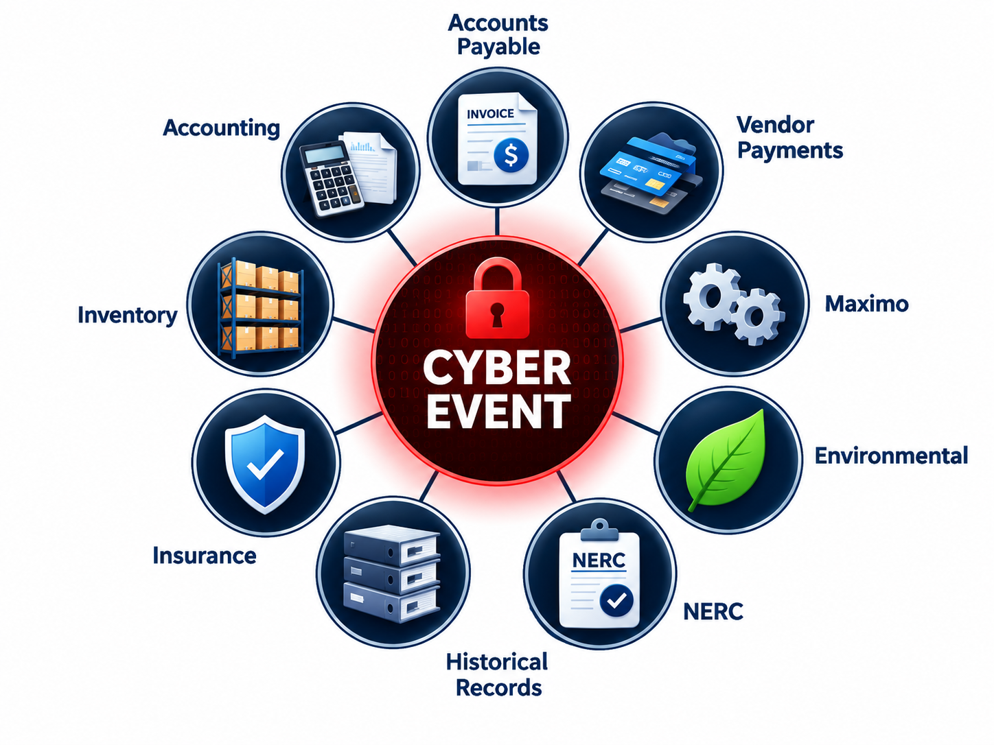
Notes:
I thought I was dealing with a cyber incident. Instead, I was dealing with business continuity.
The important distinction is that the incident affected our business IT network, not the OT/process control network. Generation continued safely, but losing the business network immediately affected functions we rely on to run the plant: accounts payable, vendor payments, Maximo, environmental and NERC records, inventory, insurance, accounting, and historical records.
That was one of my biggest lessons. A business-network cyber event can become a plant-management issue very quickly, even when the process network remains secure.

Slide 14
IT Network Failure | The Plant Manager Lesson
Scope
Accountability
Verification
Recovery
Exactly what does the managed service provider own?
Who is responsible for patching, remote access, backups, monitoring and escalation?
How do we know controls are working before an incident?
Can the site operate and rebuild if business IT disappears tomorrow?
“Managed IT” does not mean “managed risk.”
11
Notes:
This is the Plant Manager perspective.,We learned that a managed-service relationship needs a very explicit scope. Helpdesk support is not the same thing as cyber ownership.,The contract and SOW should define IT/OT boundaries, privileged remote access, patching, backup responsibilities, monitoring, incident escalation, service levels and evidence that the controls are actually being performed.,A Plant Manager does not need to become a cyber security expert, but we do need to know who owns the risk and how that ownership is verified.,,[Sources],

Slide 15
IT Network Failure | From Event to Improvement
Clarify IT / OT boundaries
Define vendor responsibilities in the SOW
Require MFA and controlled privileged access
1
2
3
Set patching and vulnerability expectations
Define backup success / restore testing (3-2-1-1-0)
Establish P1 incident response and escalation
4
5
6
Contract language should describe the service you think you are buying.
12
Notes:
Land the cyber section on practical contract and governance improvements.,Our post-event SOW work specifically calls out the IT/OT boundary, RACI, named privileged access, MFA, session logging, service severity definitions, uptime expectations, patch windows and backup expectations.,The takeaway for another Plant Manager: pull out your managed IT agreement and ask whether it actually says who owns these things.,,[
"One of the recommendations that came out of the RCA was moving toward a 3-2-1-1-0 backup strategy. The important takeaway for me wasn't memorizing the numbers. It was recognizing that modern ransomware doesn't just target your production systems—it targets your backups too. Today, we don't just ask if backups exist. We ask whether they're isolated, immutable, and whether we've actually proven we can restore from them
What is the 3-2-1-1-0 strategy?
This has become one of the cybersecurity industry's recommended backup practices, especially for ransomware resilience.
3 copies of your data
Production copy
Backup #1
Backup #2
2 different storage media
Example: disk + cloud
1 copy kept off-site
1 copy that is offline or immutable
Cannot be modified or encrypted by ransomware
0 backup errors
Verified through monitoring and successful restore testing

Slide 16
GE Stator Rewind
Generator Stator Rewind
OEM work still requires owner and plant quality control.
13
Notes:
The third event is different because this was specialized OEM work. CTA and the steam turbine generator were rewound by GE in spring 2023.
In May 2025, GE borescope inspections identified major corona activity on the end windings. On CTA, the report noted inner-basket corona arcing/burning. PSE and NAES also documented white powder, black and brown residue, and very small gaps between some bars, approximately 1/16 inch.
The management concern was the timing: this was appearing roughly two years after a rewind, not after a normal winding life.
That immediately turned the discussion from a technical observation into a quality and acceptance question.
[Sources]
Ferndale - GE Quality Concerns.pdf, July 9, 2025, pp. 1–2.
CTA__CTB__STC_Emergent_Outage_2025.pdf, stator end-winding inspection sections.

Slide 17
GE Stator Rewind | What Did We Find?
SPRING 2023
MAY 2025
QUALITY CONCERN
CTA and STG stator rewinds completed by GE Vernova.
Borescope inspection identified major corona activity on the rewound end windings.
Small end-winding gaps, visible residue and increased phase-to-phase partial discharge raised long-term reliability concerns.
The issue appeared roughly two years after the rewind, not after decades of service.
Plant Manager question: What evidence defines “acceptable” before the unit is returned to service?
Events to Improvements | GE Stator Rewind
Notes:
The third event is different because this was specialized OEM work. CTA and the steam turbine generator were rewound by GE Vernova in spring 2023.
In May 2025, GE borescope inspections identified major corona activity on the end windings. On CTA, the report noted inner-basket corona arcing/burning. PSE and NAES also documented white powder, black and brown residue, and very small gaps between some bars, approximately 1/16 inch.
The management concern was the timing: this was appearing roughly two years after a rewind, not after a normal winding life.
That immediately turned the discussion from a technical observation into a quality and acceptance question.

Slide 18
GE Stator Rewind | Two Different Views of the Same Condition
PSE / NAES concern
GE position
End-winding gaps as small as ~1/16”
Major corona appeared within two years of rewind
Partial-discharge data increased phase-to-phase
HiPot is a suitability-for-service test, not proof of long-term condition
Corona is common on air-cooled 7A6 generators
Humidity, oil, dirt and cleanliness can contribute
Electrical testing was satisfactory for return to service
GE stated it did not see a heightened forced-outage risk from the observed condition
Plant Manager lesson: when technical opinions differ, the contract and acceptance criteria become critical.
Events to Improvements | GE Stator Rewind
Notes:
I want to present this fairly because there were two different technical positions.
PSE and NAES believed the observed corona was abnormal for a winding only two years old and correlated it with very small end-winding gaps and increased phase-to-phase partial discharge. We also did not view a successful HiPot as proof that there was no longer-term degradation.
GE's position was that end-winding corona can occur on air-cooled 7A6 generators, that environmental contamination can influence it, and that the electrical tests indicated the winding was suitable to return to service. GE also stated it did not foresee a heightened forced-outage risk from what had been observed.
For a Plant Manager, the lesson is not to referee generator physics. The lesson is that when two qualified parties disagree, the written scope, specifications, testing requirements and acceptance criteria are what protect the owner.
Bi annual PD tests are conducted
[Sources]
Ferndale - GE Quality Concerns.pdf, July 9, 2025.
PSE NAES_Ferndale Letter.pdf, GE Vernova response dated July 29, 2025.
CTA__CTB__STC_Emergent_Outage_2025.pdf, stator testing and recommendations.

Slide 19
GE Stator Rewind | The Contractual Lesson
Since quality matters, define it before the work starts.
1 Scope
2 Hold Points
3 Acceptance
Specify required inspections and tests
Identify exceptions before award
Define workmanship requirements
Owner witness points
Measured data before closeout
No continuation until acceptance
Objective pass/fail criteria
Final documentation package
Warranty and remedy language
Thorough Inspection 1 Year Afterwards
A reputable OEM is not a substitute for plant/owner QA/QC.
Events to Improvements | GE Stator Rewind
Notes:
This is where I would spend most of my time on the GE case.
Our original 2023 scope included specific pre-service testing, including a corona-camera test. GE took exception to some of those tests. In hindsight, that is exactly the kind of contractual exception that deserves more attention because it changes how quality will be demonstrated before acceptance.
The 2025 outage is a useful contrast. GE and the customer developed a quality control plan with hold points at critical milestones, and closeouts required visual verification by the customer representative, APM supervisor and field engineer.
The takeaway is simple: if a test, measurement, spacing, inspection or documentation package matters to us, it needs to be explicitly in the scope with a defined acceptance criterion and research the exceptions.
A reputable OEM brings expertise. It does not eliminate the owner's responsibility to verify quality.
[Sources]
Ferndale - GE Quality Concerns.pdf, section 'Omission of Critical Pre-Service Testing.'
CTA__CTB__STC_Emergent_Outage_2025.pdf, Executive Summary / Quality section.

Slide 20
What These Events Have in Common
What These Events Have in Common
ASSUMPTION
VERIFICATION
OWNERSHIP
“Like-kind”
“Managed IT”
“OEM responsibility”
Specifications
Controls
Acceptance criteria
The Plant Manager still owns the outcome.
Trust expertise. Verify the controls around it.
15
Notes:
Bring the three stories together.,In each event, there was a reasonable-sounding assumption: the part was like-kind, the IT environment was managed by a specialist, or the OEM owned the technical work.,The lesson is not to distrust vendors or experts. It is to verify the controls around the work: specifications, scope, responsibilities, hold points, testing, documentation and acceptance.,,[Sources]

Slide 21
From Events to Improvements
Three questions to take back to your plant
1
Where are we relying on “like-kind” without enough proof?
2
What critical responsibilities do we assume a vendor owns?
3
Where do our contracts and QC plans need clearer acceptance criteria?
Questions?
16
Notes:
Close by turning the presentation back to the audience.,These are the three questions I would ask another Plant Manager after our experience at Ferndale.,Then open the floor for Q&A.,Target total presentation time: approximately 25 minutes, leaving 5 minutes for questions.,,[Sources]

